Slide 1
Digital Portfolio
STUDENT NAME:M.SHERIL MAJALA
REGISTER NO AND NMID: 24133051802522041
DEPARTMENT:BSC computer science
COLLAGE:IMMACULATE CLLEGE FOR WOMEN COLLEGE/ UNIVERSITY ANNAMALAI UNIVERSITY

Slide 2
PROJECT TITLE
BRAINSTORM KEYWARDS

Slide 3


AGENDA
Problem Statement
Project Overview
End Users
Tools and Technologies
Portfolio design and Layout
Features and Functionality
Results and Screenshots
Conclusion
Github Link
3/21/2024 Annual Review

Slide 4


PROBLEM STATEMENT

Slide 5
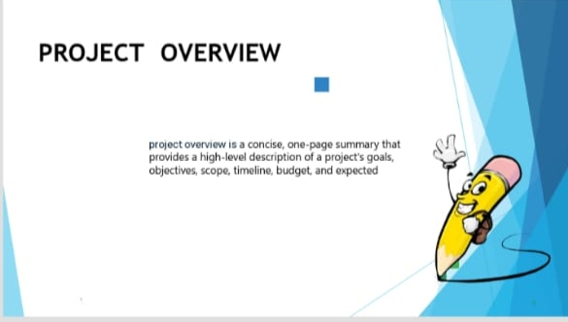

PROJECT OVERVIEW

Slide 6


WHO ARE THE END USERS?

Slide 7


TOOLS AND TECHNIQUES

Slide 8

POTFOLIO DESIGN AND LAYOUT
8

Slide 9
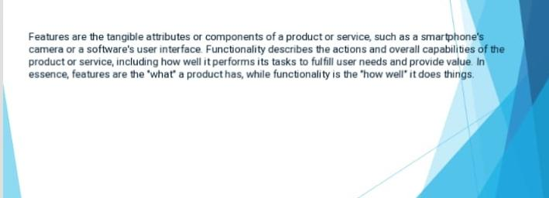
FEATURES AND FUNCTIONALITY

Slide 10
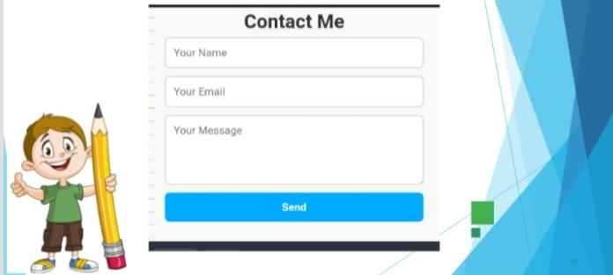

RESULTS AND SCREENSHOTS
3/21/2024 Annual Review
10

Slide 11
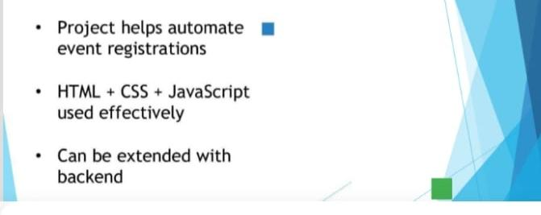
CONCLUSION
11

